Slide 1
GLOWBOX A/B TESTING
Matej Papac
25/11/2023

Slide 2
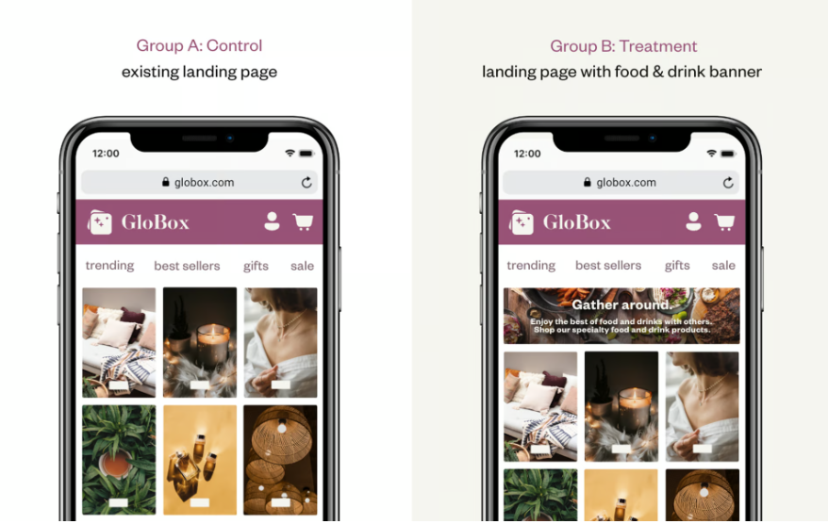
introduction
The Growth team decided to run an A/B test that highlights key products in the food and drink category as a banner at the top of the website. The control group does not see the banner, and the test group sees it as shown.
The experiment is only being run on the mobile website.

Slide 3
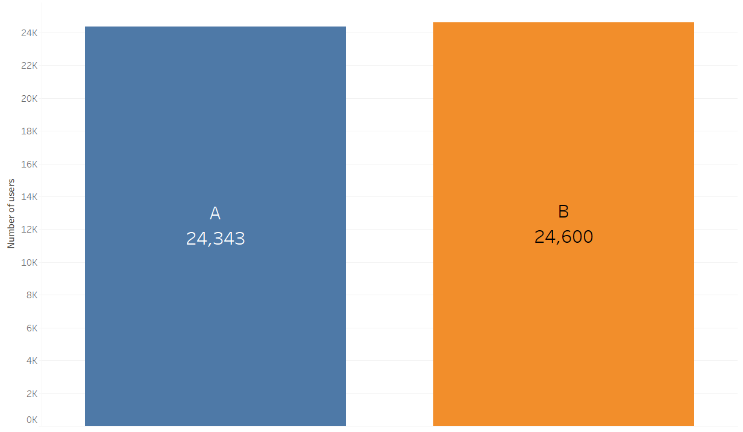
Overview
The experiment ran for 13 days (26.1.2023-05.02.2023). There were 48943 distinct users, 24343 in control and 24600 in treatment groups.

Slide 4
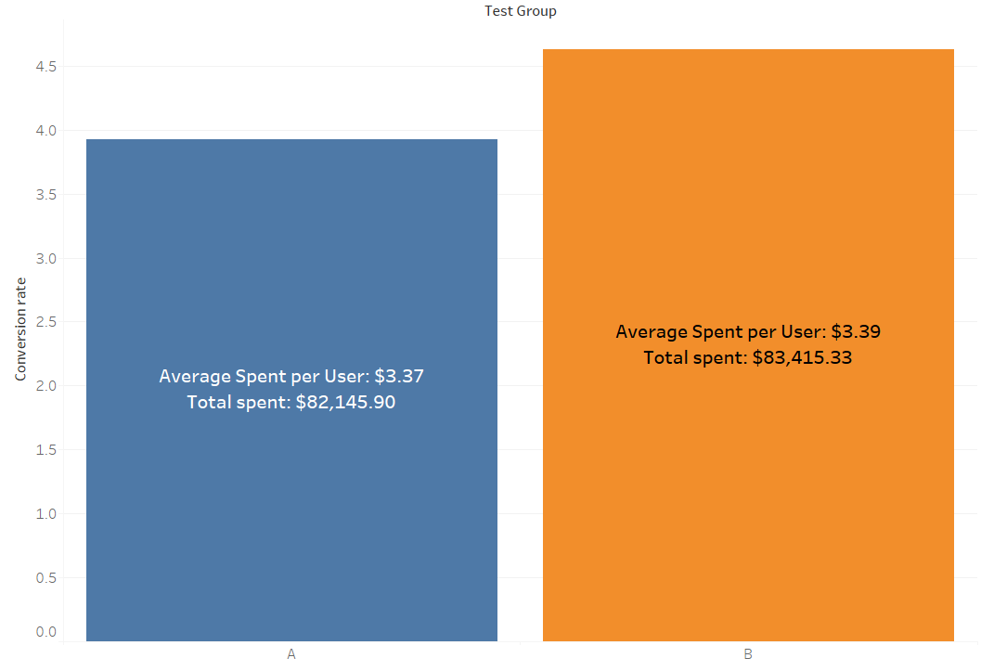
Control group
Treatment
group
Performance
difference
RESULTS
A significantly higher conversion rate in the treatment group → a positive impact from the implemented changes
No significant difference in the average or total expenditure between the groups

Slide 5
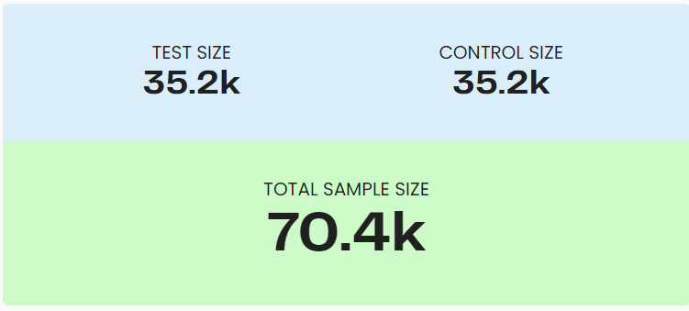
Sample size
Based on our testing parameters, we've identified the precise user sample size needed for statistically significant A/B test results.

Slide 6
Recommendation
“
Based on our tests a difference in conversion rates is showing, but only a slight variation in spending. It is advisable to collect more data. This additional data will provide a more robust understanding of customer behavior and inform better decision-making.
”

Slide 7
THANK YOU
Matej Papac
papac.tmrip@gmail.com

